Slide 1

CEIS106 Linux
Final Presentation
Shannon Clinton

Slide 2


Introduction
In this course I had the opportunity to learn a great deal about Linux and the importance of it within the IT industry. We went over a number of Linux fundamentals which include:
  Filesystem Hierarchy
  Shell Scripts
  User and Group Management
  Network Configuration
  System Performance Maintenance

Slide 3
Linux Filesystem Hierarchy

Slide 4
Navigate the Linux filesystem tree
1. What is the pwd command an acronym for? What about the cd command?
pwd - Print working director
cd – Change directory
2. Explain the differences between a relative path and an absolute/full path in Linux.
In Linux, the differences between an absolute path and a relative path is in the filename path formatting. The relative path begins with a dot, representing the current working directory. Most users don’t want to see the full path name as their prompt. Instead, a relative path starts from the current directory and the absolute directory can be found by typing the command pwd. Here is an example of the two different formats
Absolute Path: /home/users/c/computerhope/public_html/CEIS106
Relative Path: ./public_html/CEIS106
References:
1. Computer Hope. (2021, February 1). What is the difference between a relative and absolute path? Linux Handbook. https://www.computerhope.com/issues/ch001708.htm#linux
2. Prakash, A. (2021, April 30). Absolute vs Relative Path in Linux: What's the Difference? Linux Handbook. https://linuxhandbook.com/absolute-vs-relative-path/

Slide 5
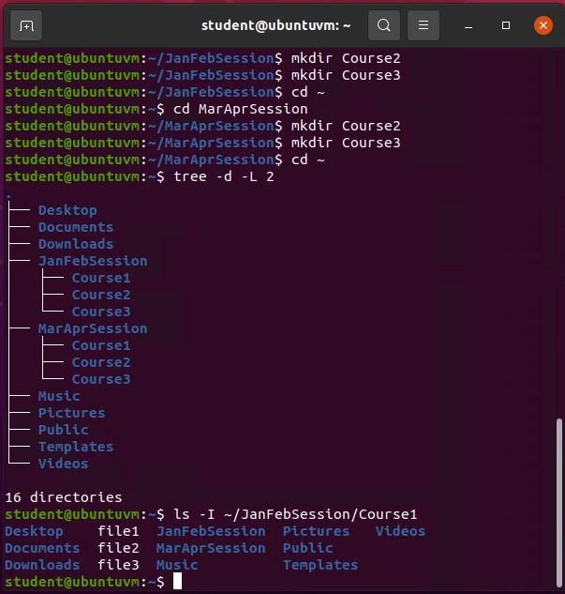
Create directories and files

Slide 6
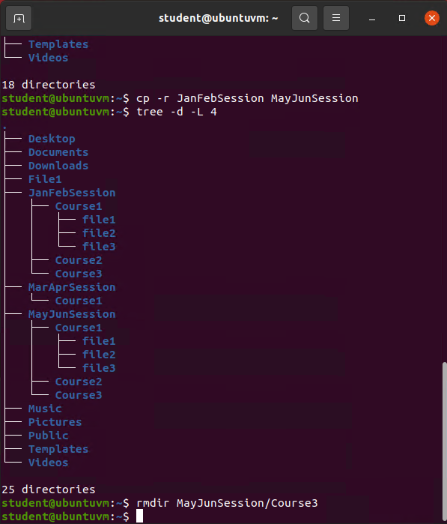
Copy and remove directories and files

Slide 7
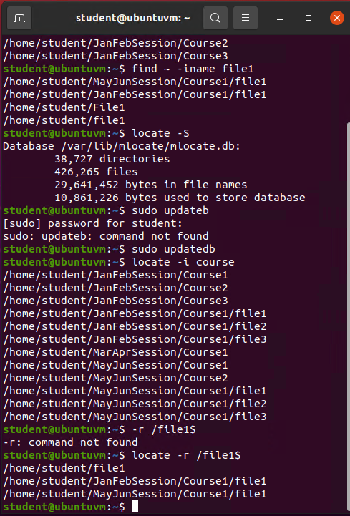
Locate directories and files

Slide 8
Linux
Shell Script

Slide 9
Create a shell script
1. What are the file permissions of the script?
ls -l todolist
2. What’s the name of the user-defined variable in the script?
MyToDoLists
3. Which redirection meta-character is used in the script? What does it do?
echo “Today’s to-do-list -- $text -- $text” >> MyToDoLists
>> Appends the command output to the file content
The redirection metacharacter allows you to redirect the contents of a file as your input. The symbol we used ‘appends’ or adds to the existing file
References:
1. 4.3. Shell Metacharacters — Introduction to Unix Study Guide. (n.d.). Shell Metacharacters - Introduction to Linux Study Guide. http://faculty.salina.k-state.edu/tim/unix_sg/shell/metachar.html
2. Niazi, R. (2022, January 9). What are Linux metacharacters. Makeuseof.Com. https://www.makeuseof.com/what-are-linux-metacharacters/

Slide 10
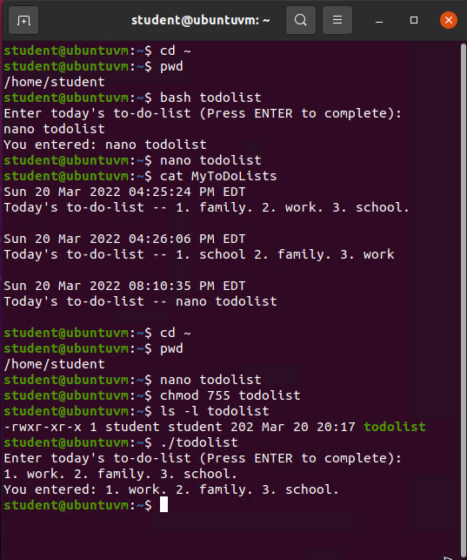
Change script file permissions

Slide 11
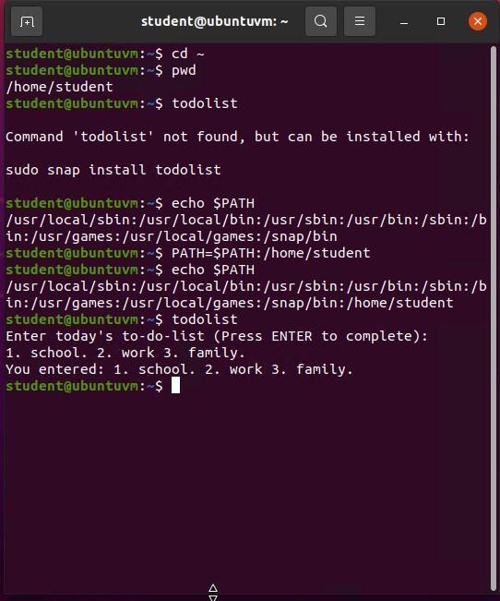
Set the PATH variable

Slide 12
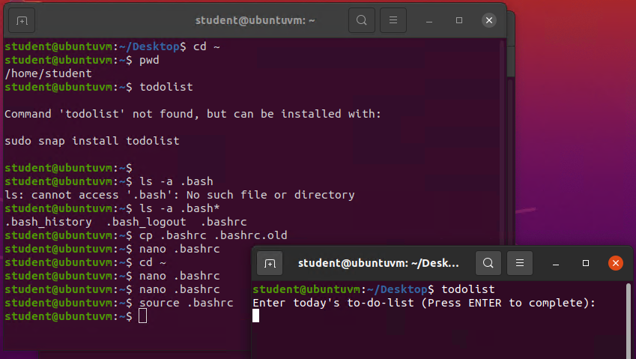
Make the PATH variable permanent

Slide 13
User and Group
Management

Slide 14
Add users and groups in CLI
1. What does the –m option in the useradd command do?
Allows copying of files from the system directory to the home directory. Allows creation of a user within the home directory.
2. What does the -3 option in the tail command do?
It shows the last few lines of the log file. The # after the – is referencing how many lines that will be shown
3. Which line of the /etc/group file lists members of the “students” group? Copy it here.
Sudo tail -3 /etc/group This shows the group # and the user # assigned to the user
References:
1. Live session
2. GeeksforGeeks. (2021, February 19). Tail command in Linux with examples. https://www.geeksforgeeks.org/tail-command-linux-examples/

Slide 15
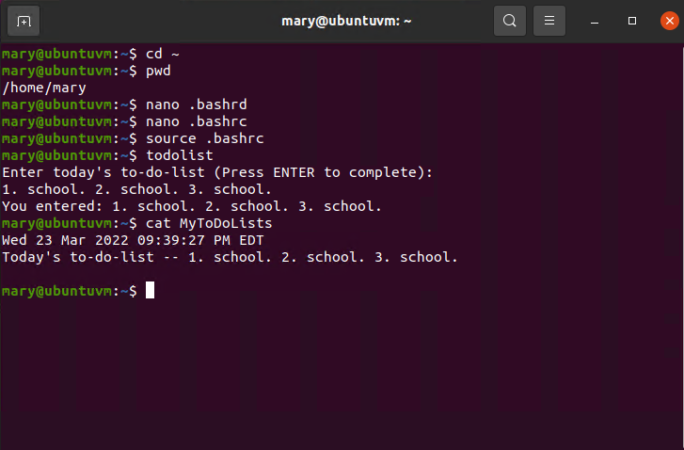
Test user and group settings

Slide 16
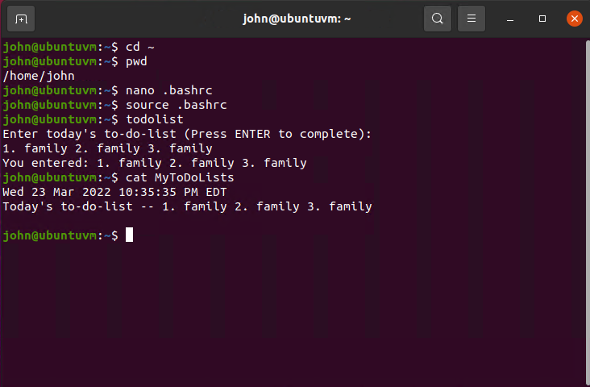
Add users in GUI

Slide 17
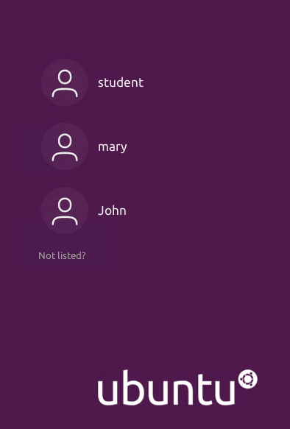
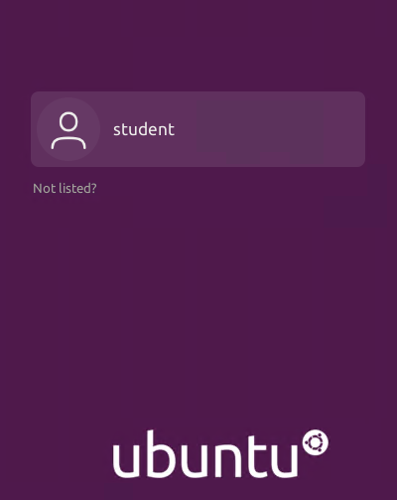

Remove users and groups

Slide 18
Network
Configuration

Slide 19
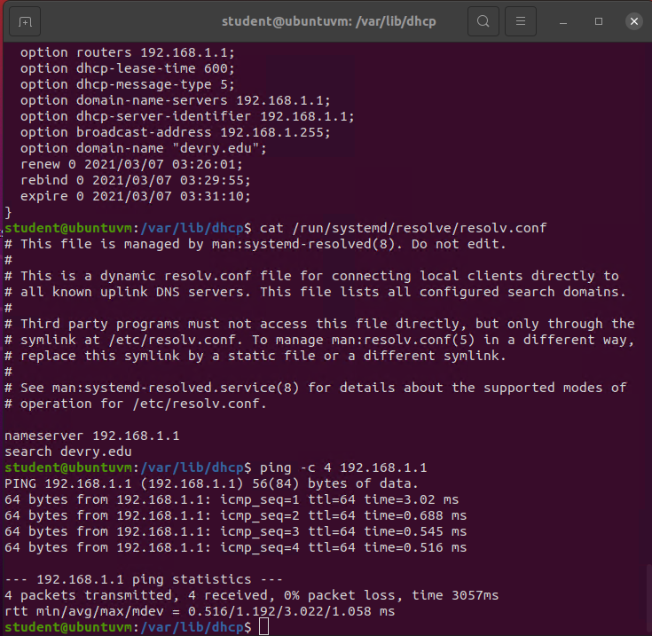
Discover host IP configurations
1. What is the IP address of your Ubuntu machine?
192.168.1.104/24
2. What is the IP address of its default gateway?
192.168.1.1
3. What is the IP address of its DHCP server?
192.168.1.1
4. What is the IP address of its DNS server?
192.168.1.1

Slide 20
Manage network interfaces
1. Which DHCP message is shown in the output of the sudo dhclient –v –r eth0 command? [hint: the message name is in uppercase.]
DHCPRELEASE of 192.168.1.105 on eth0 to 192.168.1.1 port 67
2. Which four DHCP messages are shown in the output of the sudo dhclient –v eth0 command? [hint: the message names are in uppercase.]
DHCPDISCOVER on eth0 to 255.255.255.255 port 67 interval 3
DHCPOFFER of 192.168.1.105 from 192.168.1.1
DHCPREQUEST for 192.168.1.105 on eth0 to 255.255.255.255 port 67
DHCPACK of 192.168.1.105 from 192.168.1.1
References:
1. Live session
2. Project guide

Slide 21
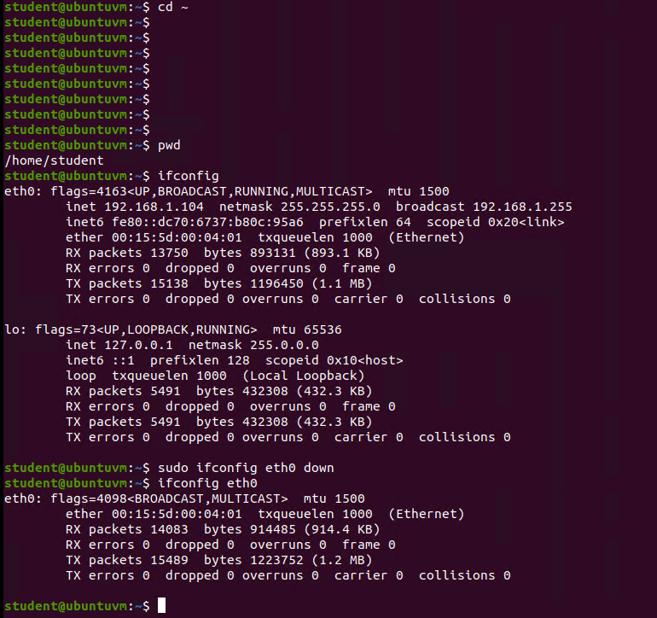
Use network utilities

Slide 22
System
Performance
Monitoring

Slide 23
Monitor Linux processes
1. What is the default action of the 15 SIGTERM kill signal?
It killed the calculator process which caused it to close
2. In the System Monitor window, click on % CPU to sort the processes by CPU load. Which process shows the highest percentage of CPU usage?
/dev/sda5/ which is the kernel and the boot related files
References:
1. Live Session
2. WHAT IS ON THE /dev/sda5 (/) PARTITION?? (2008, December 31). cPanel Forums. https://forums.cpanel.net/threads/what-is-on-the-dev-sda5-partition.83073/

Slide 24
Monitor user activities
Issue the sudo accton on command to turn on GNC accounting. Run the sudo updatedb command. Enter lastcomm updatedb to check if the updatedb command was executed before. Remember to turn off GNC accounting (sudo accton off) after answering the questions.
1. What flag value is displayed in the output?
S Flag
2. Why is the name of the user who ran the processes shown as root, not student?
This process is run by the super user
References:
1. Project Guide
2. lastcomm - Unix, Linux Command. (n.d.). TutorialsPoint. https://www.tutorialspoint.com/unix_commands/lastcomm.htm

Slide 25
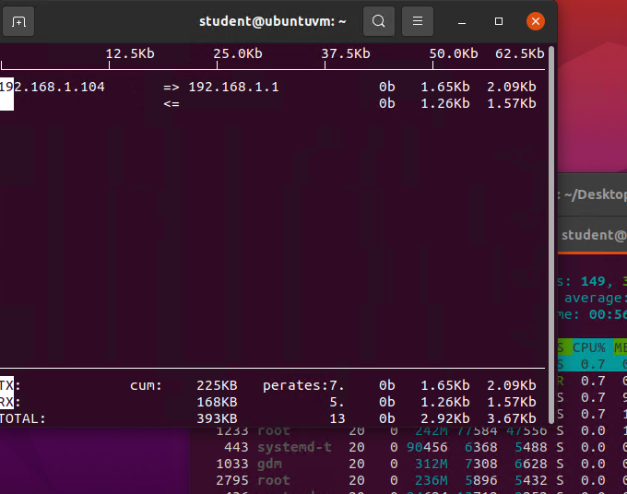
Monitor network bandwidth usage

Slide 26
Challenges
My main challenge during this class was that I’ve had zero exposure to Linux previously. I knew this would be a steeper learning curve for me and a lot of memorization. I found the prospect intimidating but I took it on as a challenge worth taking on!

Slide 27
Career Skills
Problem Solving
Navigating Linux
Ubuntu Experience
BASH Scripting
Presentation Skills

Slide 28
Conclusion
I learned a lot in this course, and I look forward to implementing it in my career. Of the topics we covered in this class I enjoyed learning command line instructions regarding user and group management, but I believe the skill that will be immediately the most useful will be having learned filesystem hierarchy.

