Slide 1


CEIS110 - Python
Shannon Clinton

Slide 2


Introduction
In this project we used a cloud-based system to gather temperature and humidity data, collected from NOAA, and then used programming as well as Excel to analyze the data.

Slide 3

Software Inventory
Spyder – Used to write the code that accessed NOAA weather database
Excel – Used to sort and chart data that was collected
NOAA Database

Slide 4
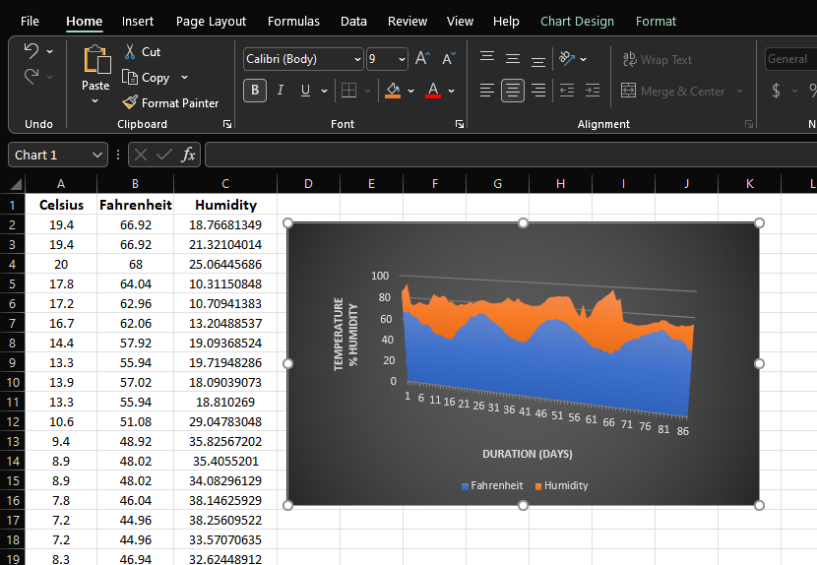
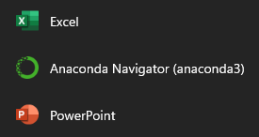
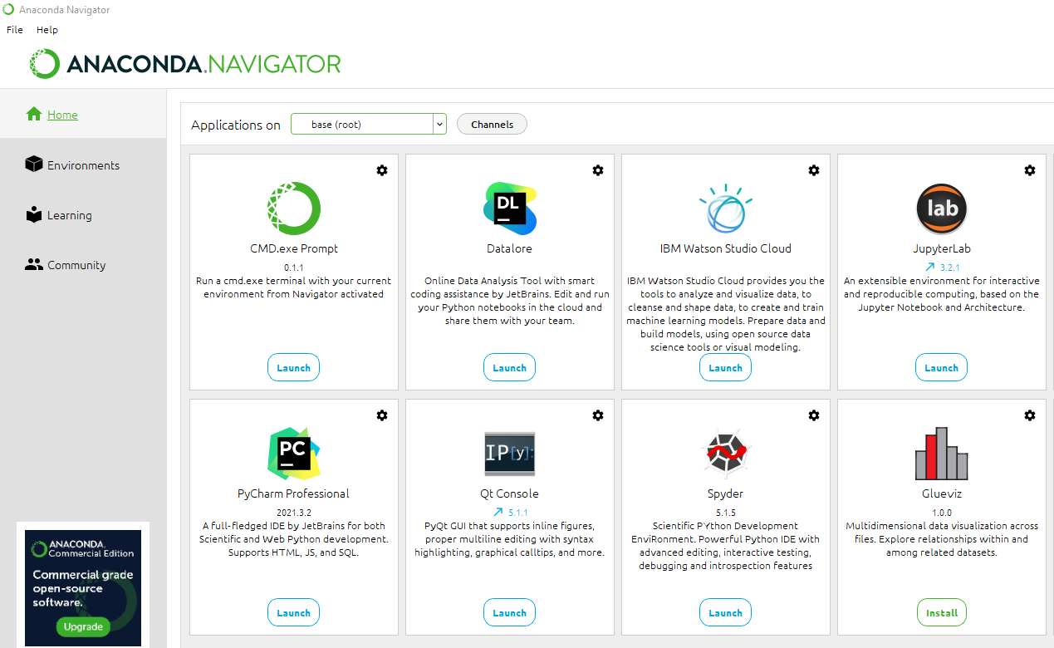
Software Used

Slide 5
Planning and Design
After performing an inventory of the software needed for the project, a plan was created for the temperature data project
To plan the design of the project, a flowchart was generated
Planning and design of the project are crucial steps to understanding the development process

Slide 6
What is a flowchart?
Flowcharts are graphical representations of processes or workflows
The flowchart developed illustrates the process and the output of this software development project
Many companies use flowcharts as simple narratives
Flowcharts are a great way of communicating the logic of a system

Slide 7
Flowchart Used
Start
Install Python Modules
Download weather data to a database
Extract weather data into CSV file
Cleanse weather data
Use Excel to manipulate data
Use Python data analytics module to develop graphical models
End

Slide 8
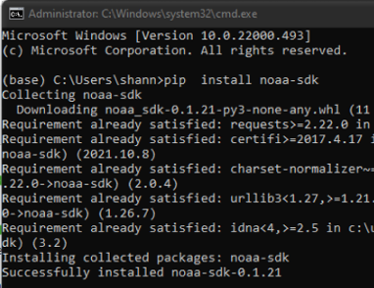
Adding a Library
In order for Python to connect to the US government National Oceanic and Atmospheric Administration (NOAA) weather data service using a cloud-based Application Programming Interface (API), a library module must be installed to use this service.
The screenshot shows the NOAA-SDK library installed

Slide 9
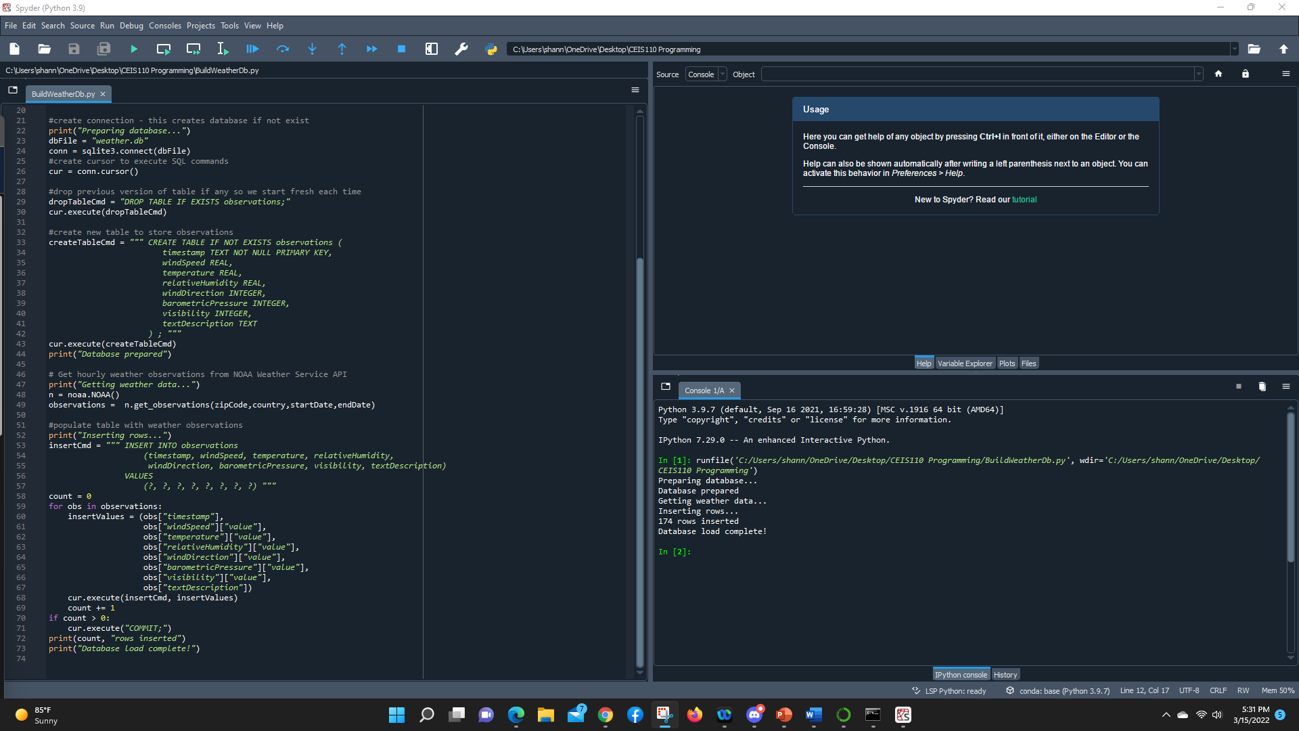
BuildWeatherDb.py Code

Slide 10
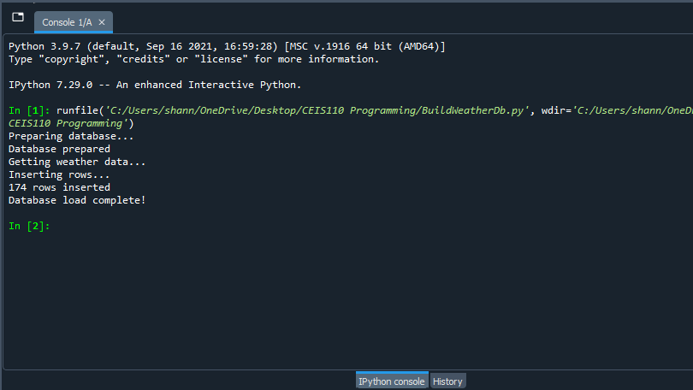
Python Console

Slide 11
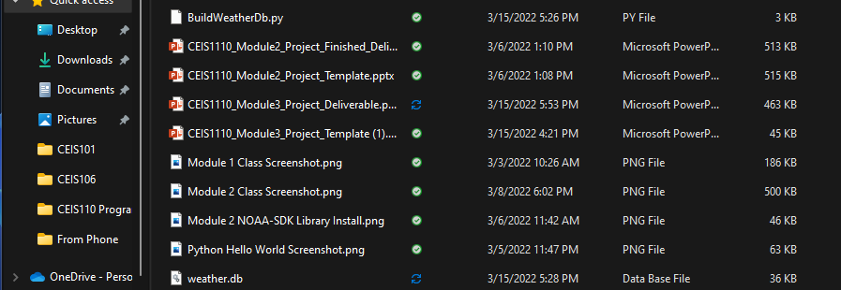

Weather.db File

Slide 12

Querying the Database
SQL is a programming language used for working with relational databases
SQL was used to query the database and view the results

Slide 13
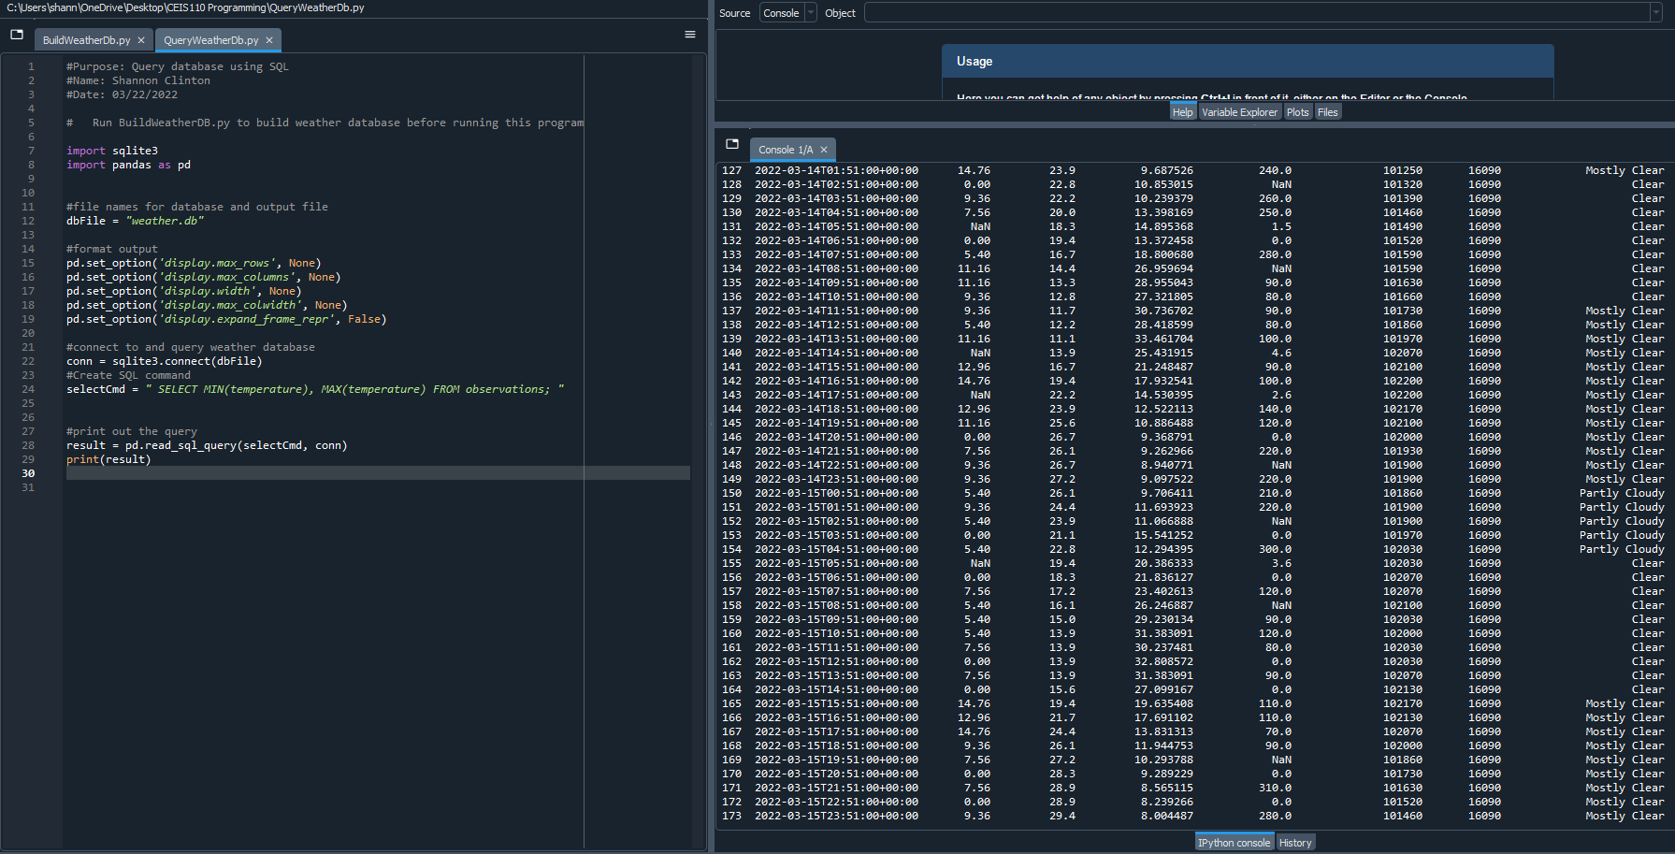
Query to retrieve all columns and all rows

Slide 14
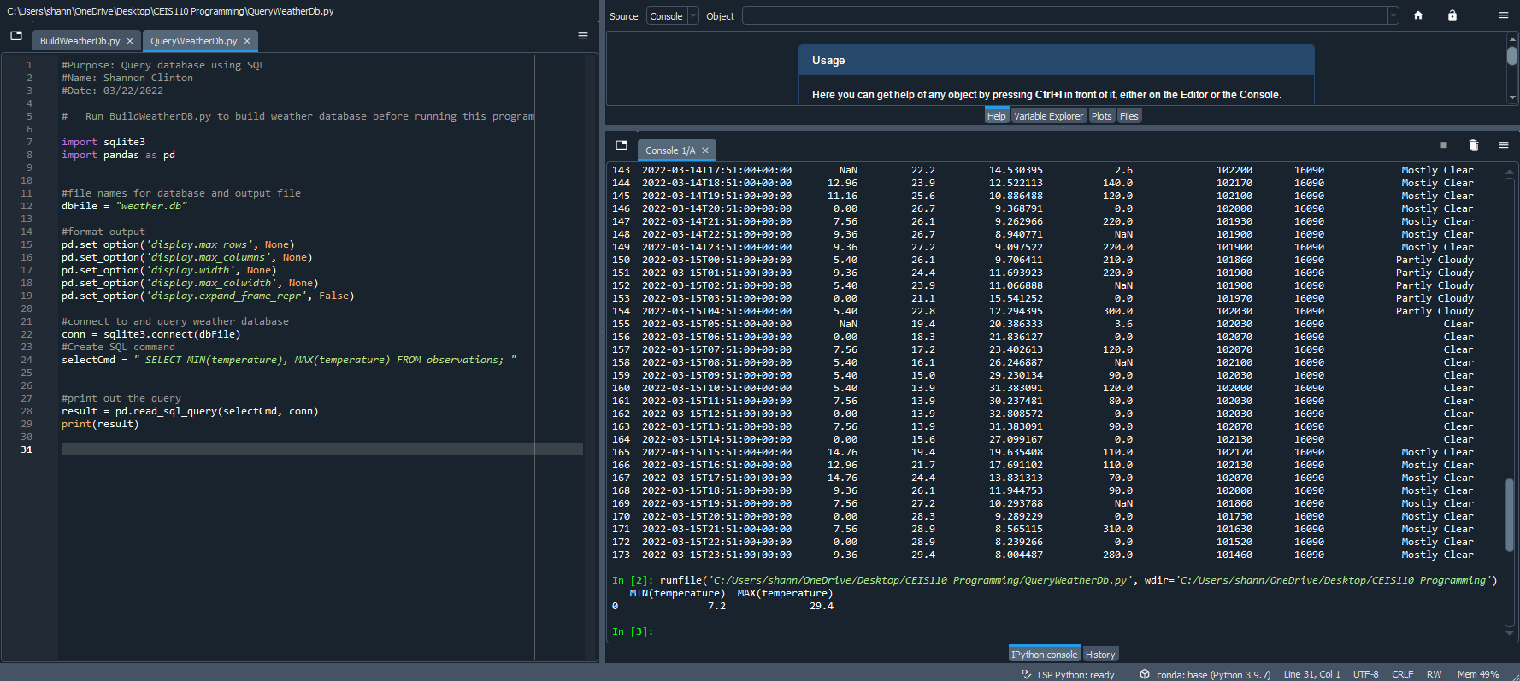
Query to retrieve temperature

Slide 15
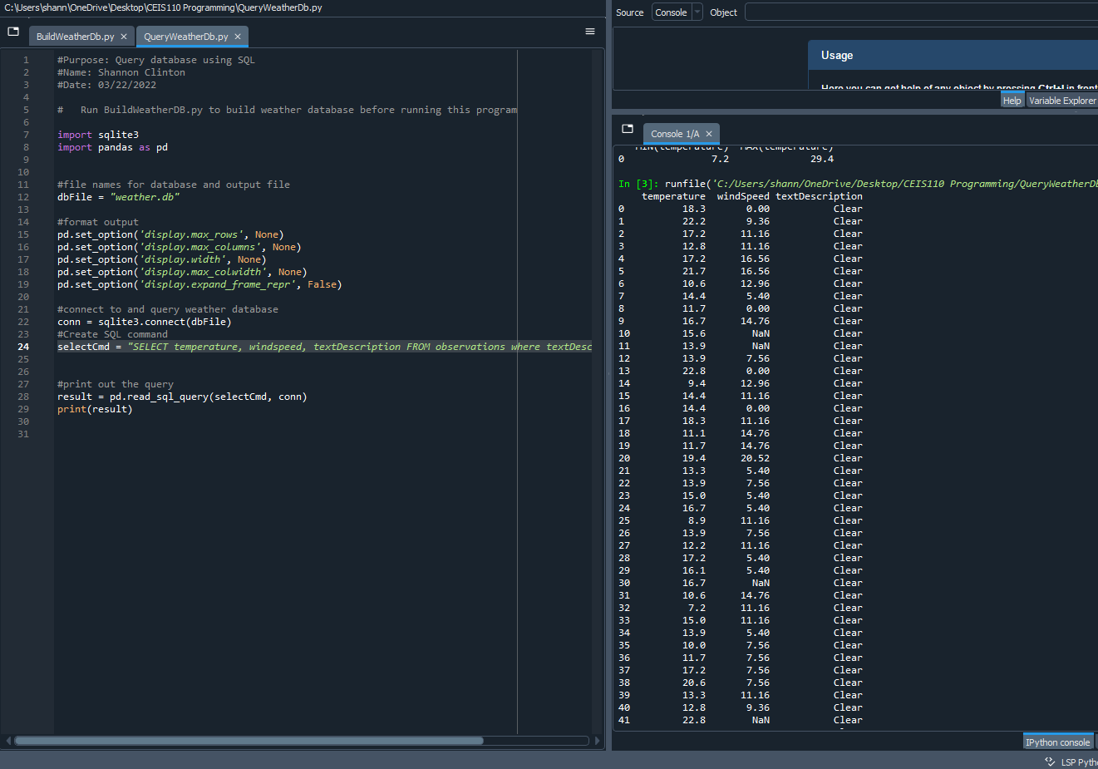
Query to retrieve all clear days

Slide 16
Data Cleansing
Data output from machines may have errors or extraneous data or missing data. When cleansing data, programs can automatically put it in the format needed to be read by other programs.
A python program is reading in the data output by the python program and saving it in a csv file so that it can be read by Excel.

Slide 17
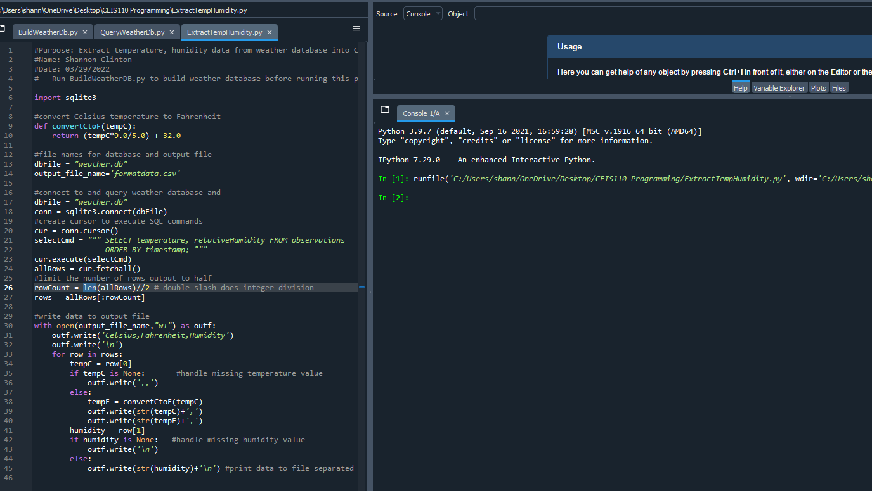
ExtractTempHumidity.py

Slide 18
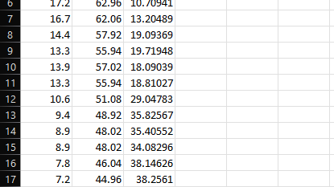
Retrieve and Convert Data to CSV Format

Slide 19
Temperature and Humidity Chart
Excel chart based on temperature and humidity data from database

Slide 20
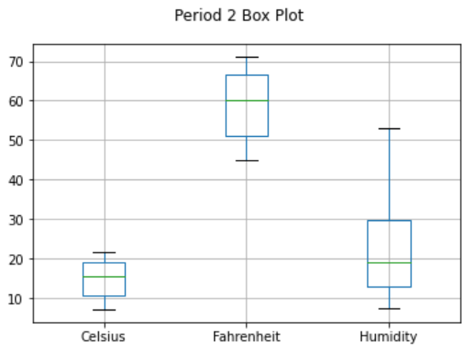
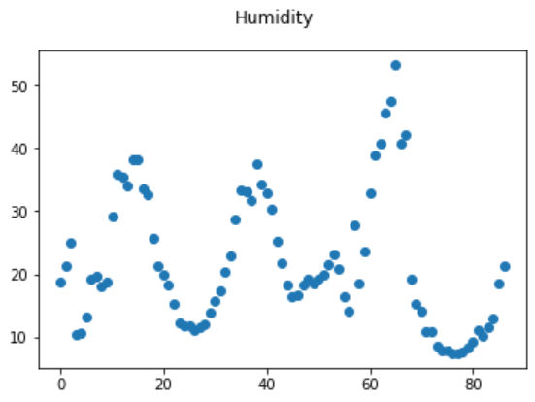
Data Plots Created in Spyder

Slide 21
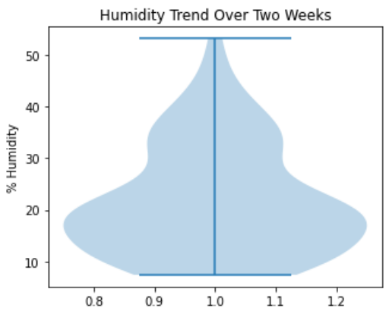
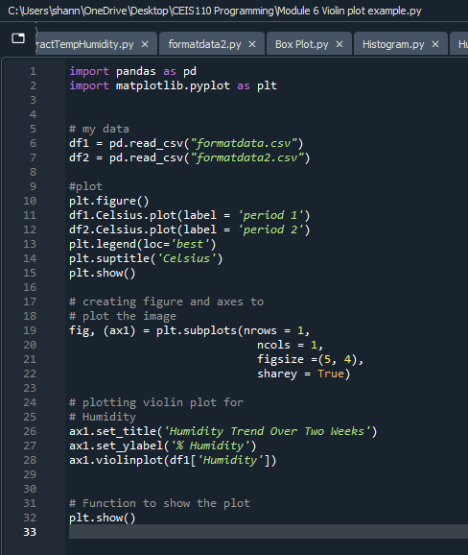
Analysis
Think of your own question and create a chart/graph to answer it
I wanted to see if I could create a violin style plot which is a variation/expansion on a box plot
Your own question:
What does the humidity distribution look like in a violin plot
Answer supported by Chart:
In Scottsdale, Az over the last 2 weeks we’ve had mostly low humidity that averages 18%-20% but there is a second visible trend around 35%.

Slide 22

Prediction
Develop a prediction based on the data. What variations in temperature and humidity do you expect over the next few hours or days? How would humidity change if temperature goes up or down?
Based on the data over the last two weeks, and living in Scottsdale my whole life, I can predict that the weather will be warm and the humidity will be low because the chance of rain is very low.

Slide 23

The challenges I encountered where:
Complete unfamiliarity with coding
Memorization of terms
Troubleshooting and finding syntax errors
Wrapping my mind around logic errors

Slide 24
Career Skills
Database development
Programming using python
Troubleshooting errors in the code
Cleansing data for use
Analysis of data

Slide 25

Conclusion
Putting together this project, as well as this presentation, gave me a hands-on learning opportunity. I worked with Python, gathering data from a cloud service as well as performed analytics on the data that was retrieved. I learned a great deal during this project and I look forward to building upon them in the future.

