Slide 1

CEIS101 Final Project
IoT Smart Home Security System
Shannon Clinton

Slide 2


Introduction
The Aurduino Mega is a fun device with so many possibilities. This project showed me that I’m capable of building a functional prototype and that the sky is the limit on what I can create and add to the IoT world.
As I move along in my education, I plan on focusing on the data management piece of IoT devices so having a fundamental understanding of the technology will be important to my career. I value this opportunity. Thank you to all the instructors for your thorough explanations on the Arduino and breadboard tech we worked with in this class.

Slide 3
Module 2
Circuit Simulation in Tinkercad

Slide 4
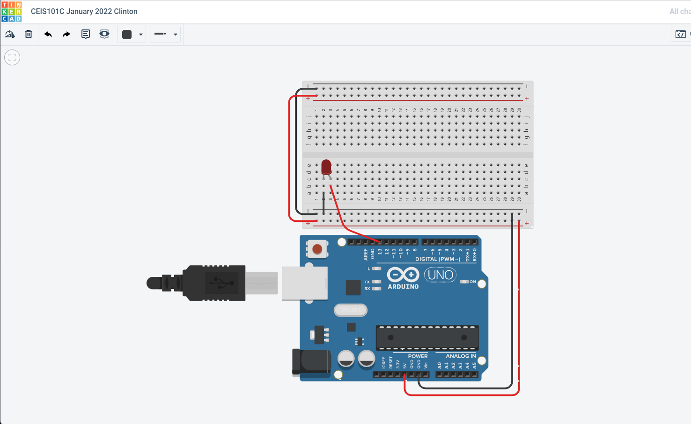
Circuit (screenshot)

Slide 5
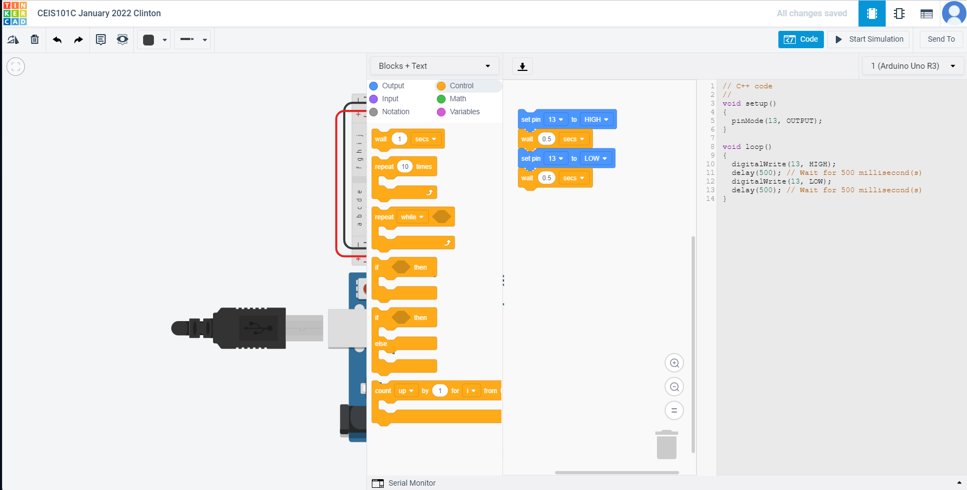
Code(screenshot)

Slide 6
Module 3
Inventory of Parts, Circuit Building, and Displaying Messages

Slide 7
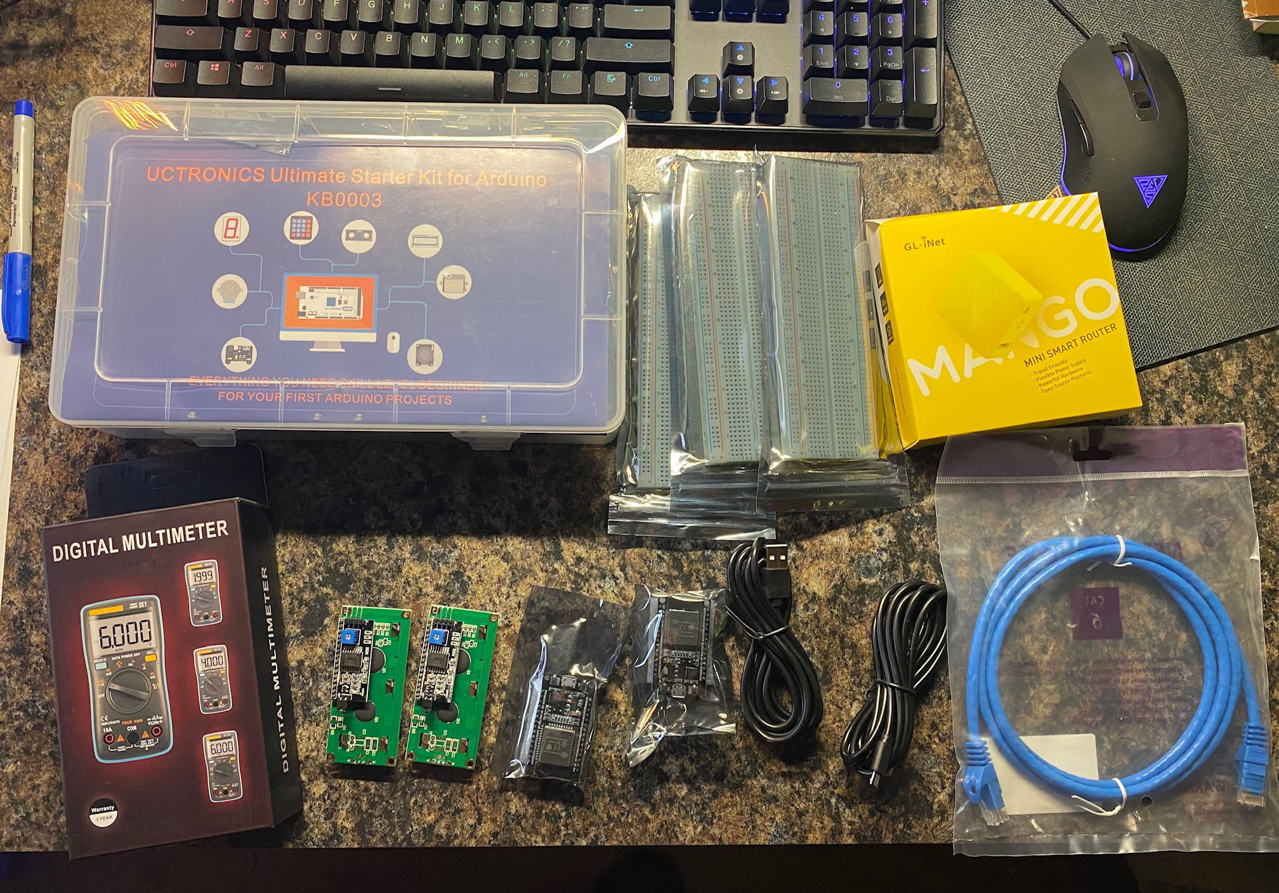
Inventory of IoT Kit (picture)
UCTRONICS Kit
ESP32 (2)
LCD Modules (2)
Breadboards (3)
Mini Router
Patch Cable
Digital Multi Meter
USB to Micro USB (2)

Slide 8
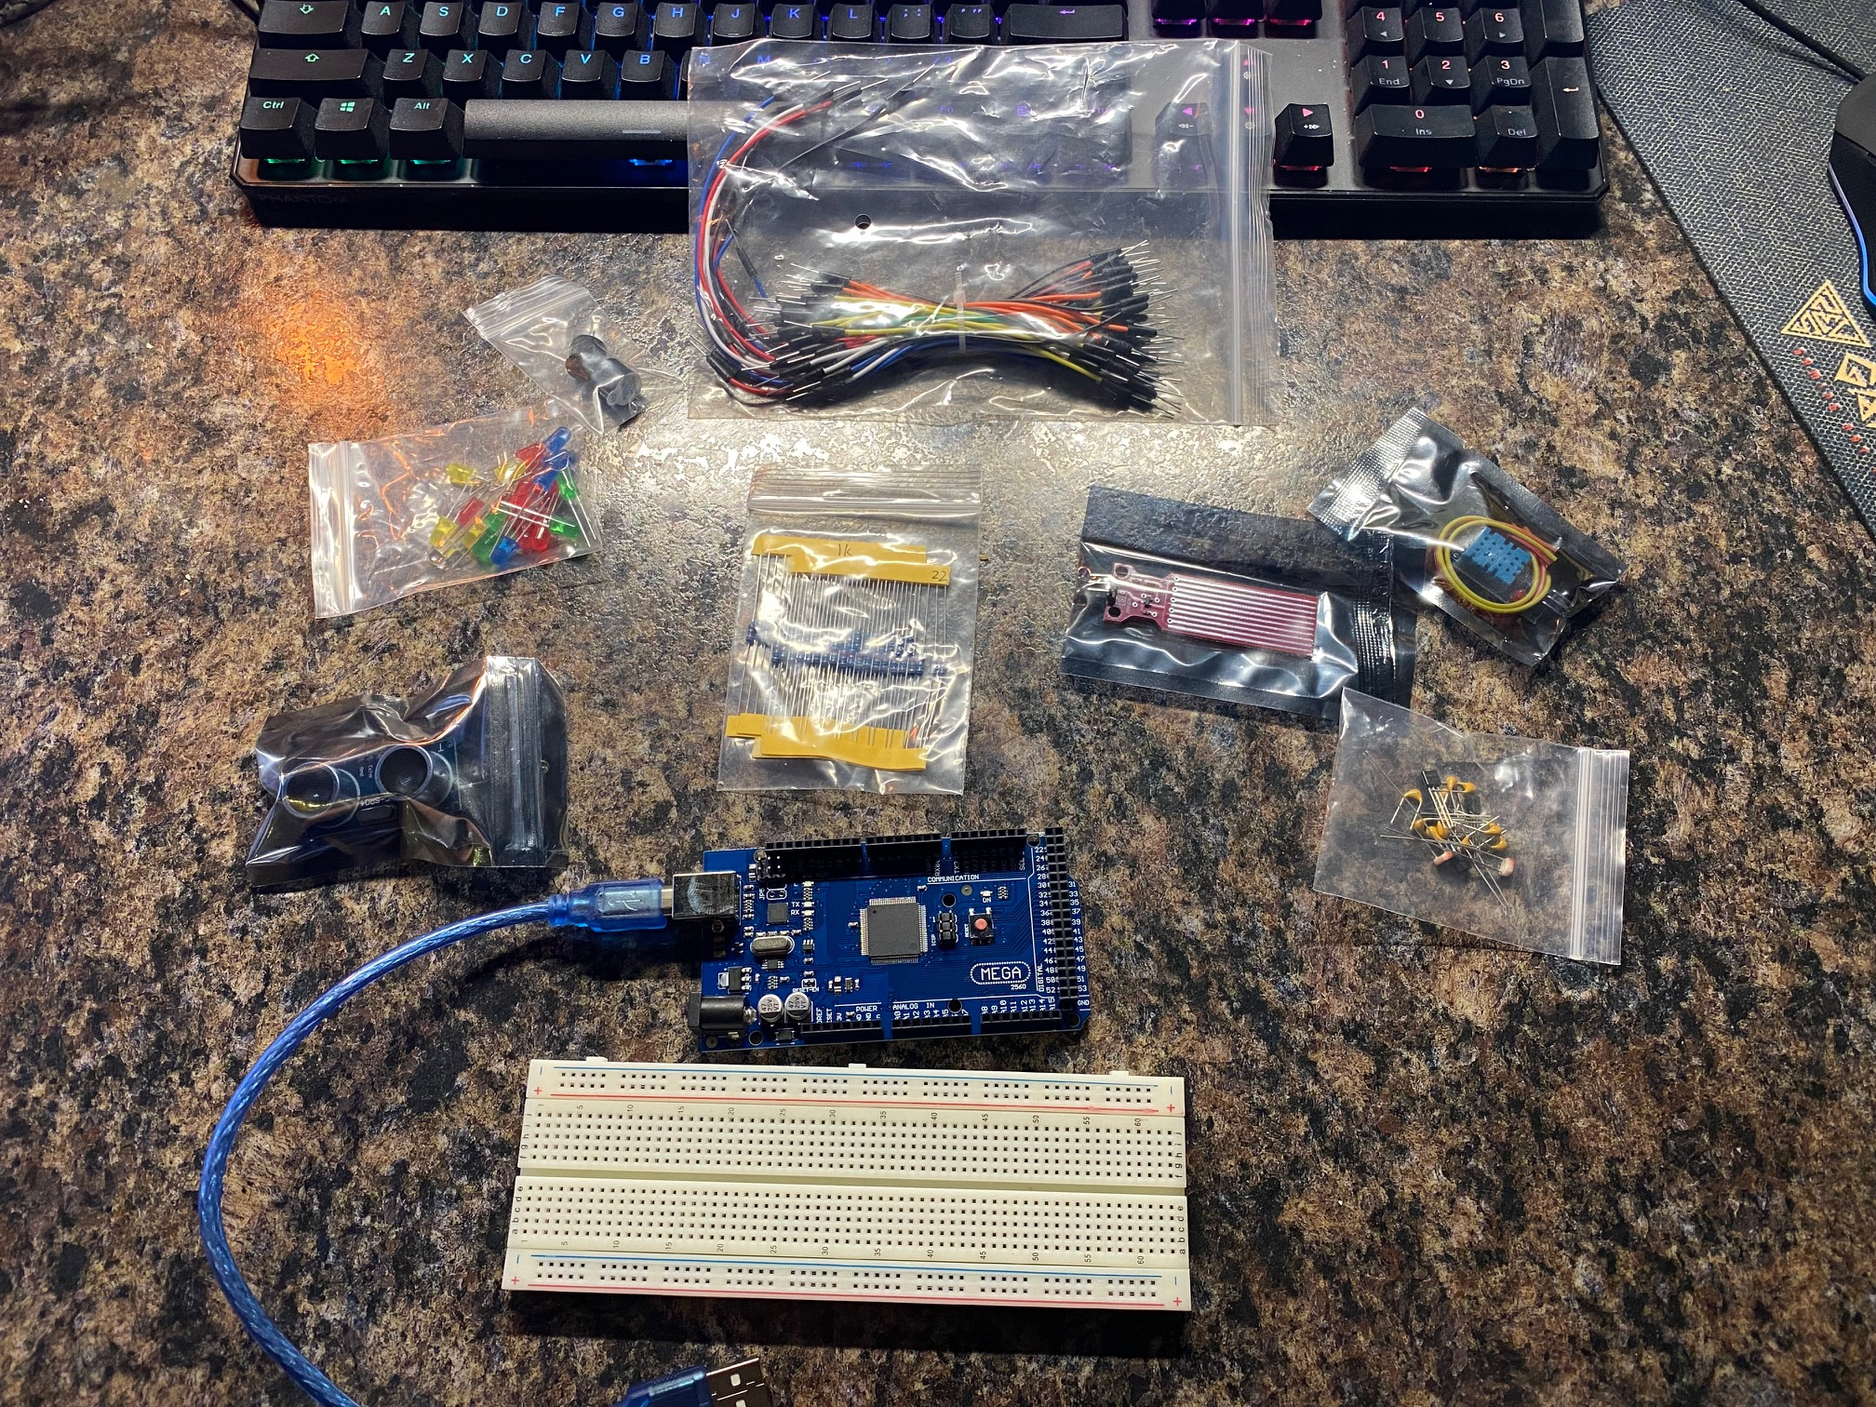
Organization of Project Components
Arduino Mega 2560
Breadboard
Resistor 10kΩ
LEDs
Ultrasonic Sensor
Active Buzzer
Photoresistor
Wires
USB Type B cable

Slide 9
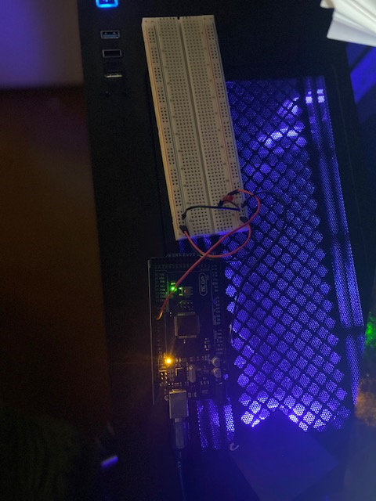
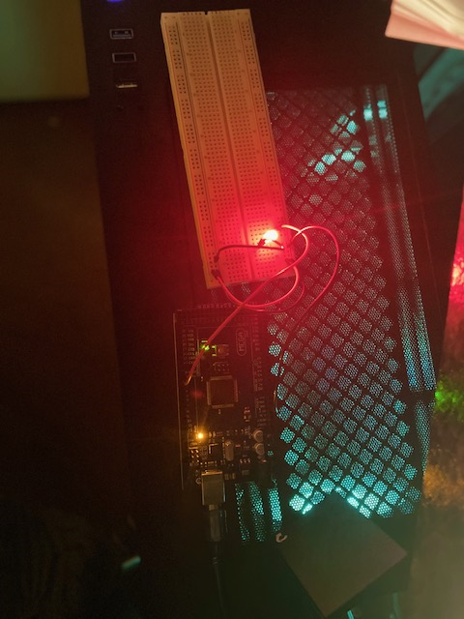
Circuit with red LED on (picture)

Slide 10
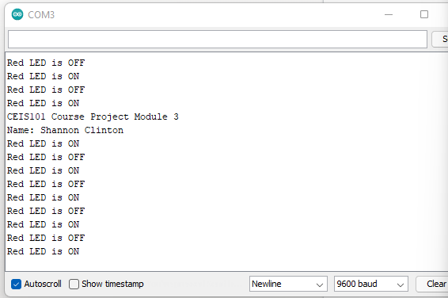
Serial Monitor (screenshot)

Slide 11
Module 4
Adding Door Sensor to Smart Home System

Slide 12
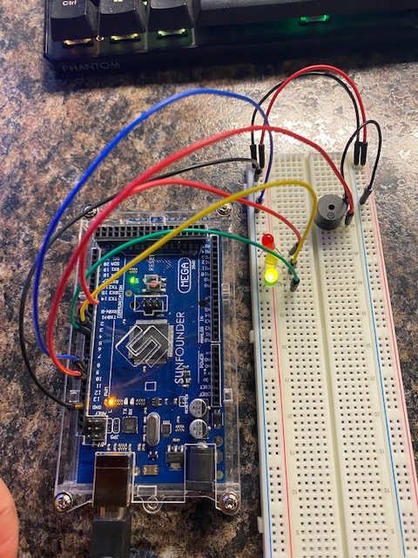
Circuit of door closed with Green LED ON

Slide 13
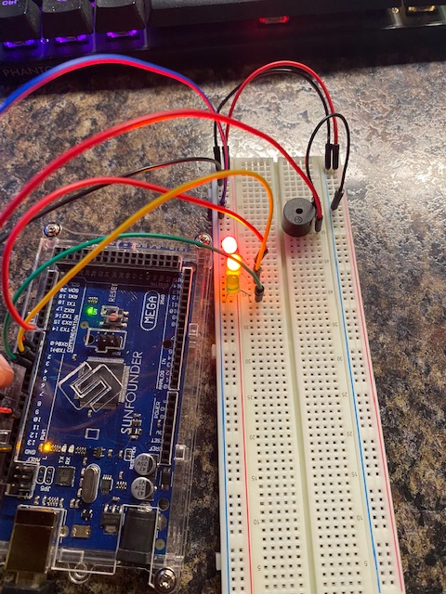
Circuit of door open with Green LED OFF

Slide 14
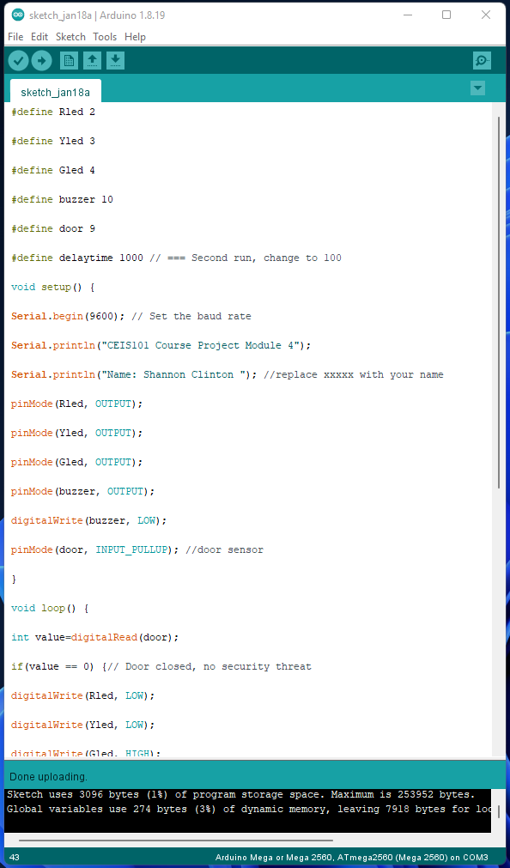
Arduino Code

Slide 15

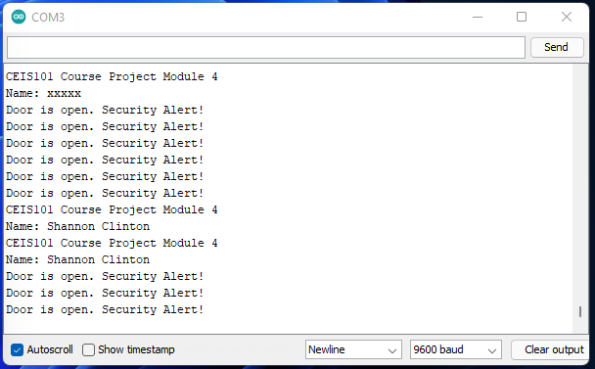
Serial Monitor (screenshot)

Slide 16
Module 5
Adding Distance Sensor to Smart Home System
and Conducting Data Analysis

Slide 17
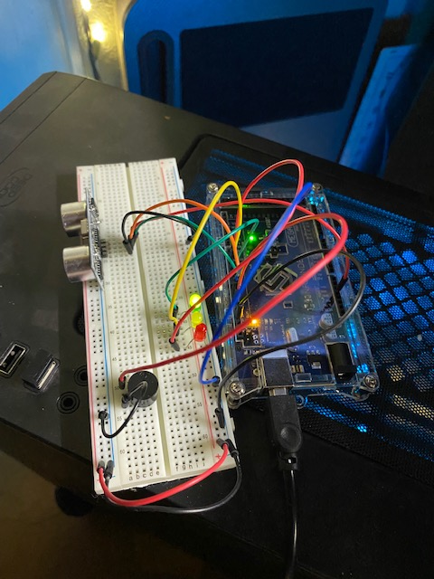
Circuit with green LED on

Slide 18
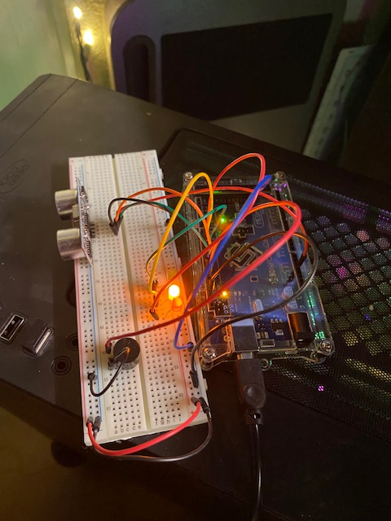
Circuit with yellow LED on

Slide 19
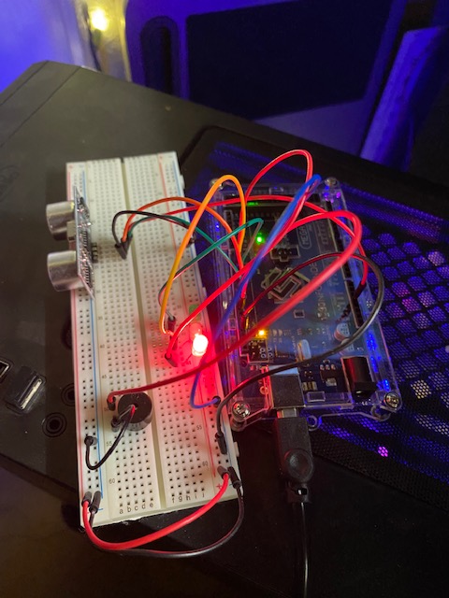
Circuit with red LED on

Slide 20
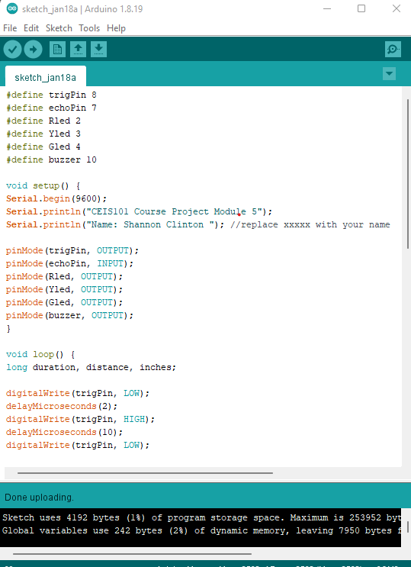
Arduino Code (Screenshot)

Slide 21
Data Output of Distance Sensor (/Sec)

Slide 22
Module 6
AUTOMATED LIGHT

Slide 23
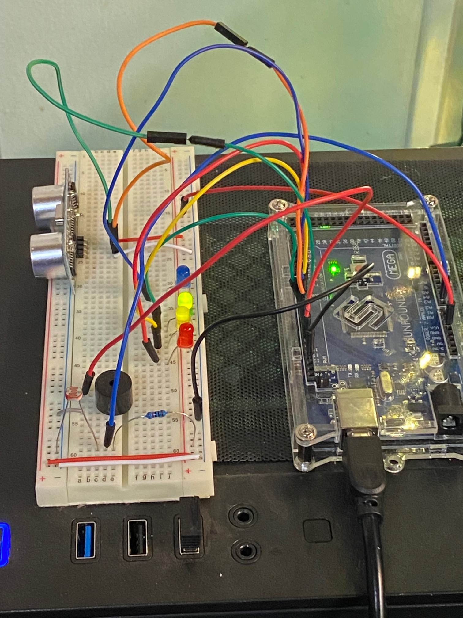
Circuit with automated LED off

Slide 24
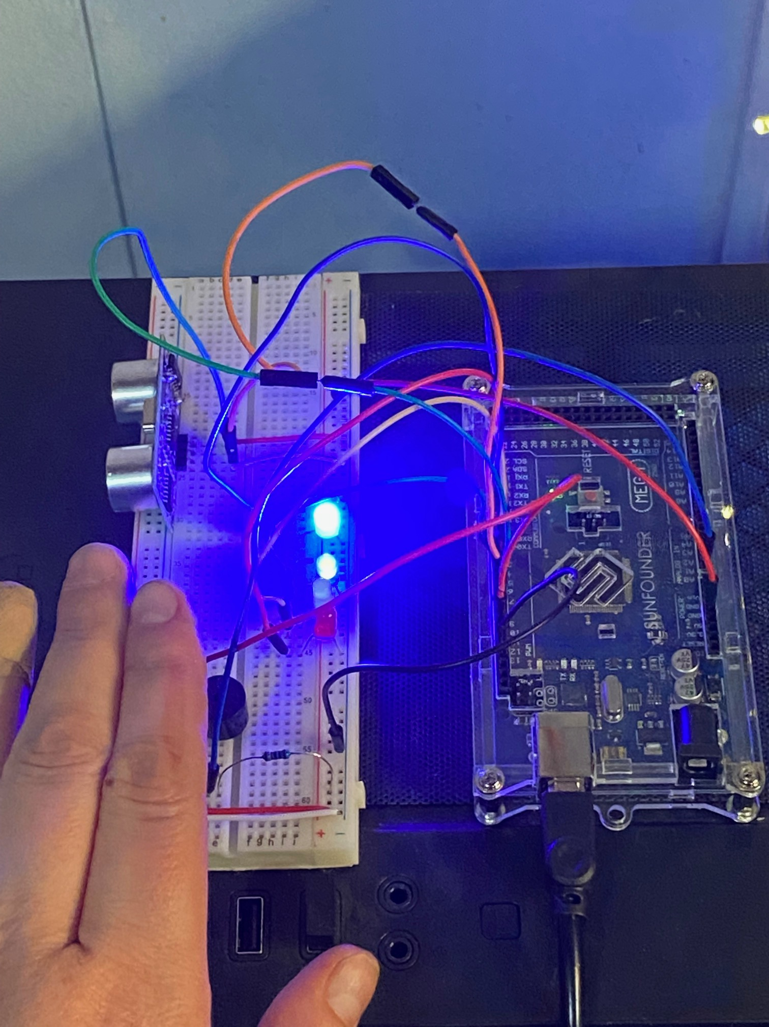
Circuit with automated LED on (picture)

Slide 25
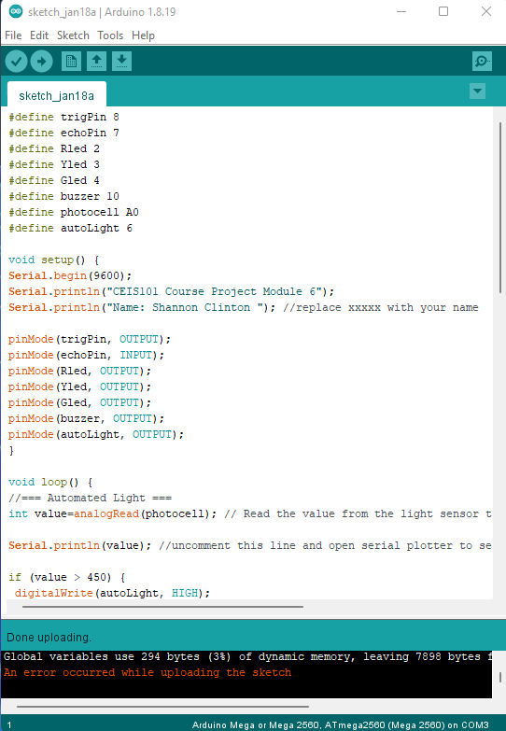
Arduino Code (screenshot)

Slide 26
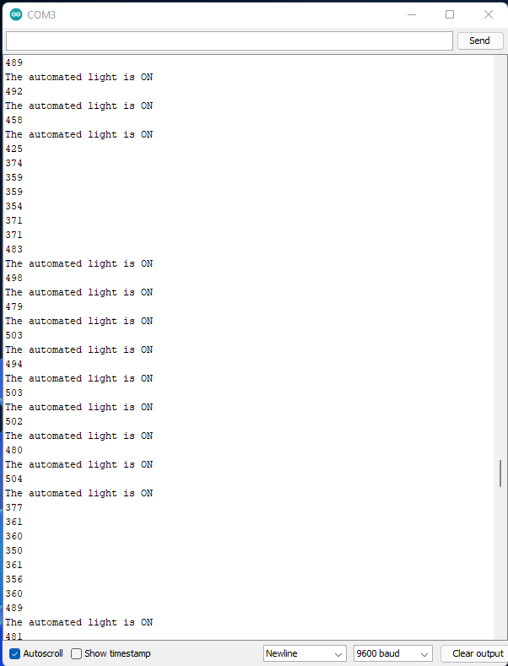
Serial Monitor (screenshot)

Slide 27
Career Skills
Building a functional Prototype
Handling the data output of the security system
Learning the basics of Arduino C+ code
Gaining a familiarity with the Arduino hardware
Building circuitry with the breadboard and learning basic electronics

Slide 28
Challenges
I had just two challenges during the building process. Overall, everything went very smoothly, and I enjoyed the process of building the prototype.
During Module 3, using the Arduino software for the first time, I couldn’t get the code to upload to my device. I first checked the settings withing the software and I discovered that I didn’t have the port selected properly. Even then though the code still wouldn’t upload so I started to get really frustrated. I attended a homework huddle with Professor Lewis and he had me unplug and fully reset my hardware and that did the trick to fix the issue.
Everything went very smoothly from there until I got to Module 6. I had to move my device to another surface within my office and when I did, so a couple of the leads came loose. I had to go over all my connections, but I missed one important one. The power from the 5V was connected to the wrong spot and I kept overlooking the problem. I worked with Andrew in my Discord study group and during that process I found the issue. I felt silly for overlooking such a simple issue.

Slide 29

Conclusion
The world of IoT is expanding exponentially right now and it’s a rapidly growing sector of the tech industry. Having the opportunity to build a functioning prototype of a home security system was exciting. I now have a confidence from the experience that I’m looking forward to exploring. There are endless possibilities to what I can create with my Arduino mega and Uno devices.

