Slide 1

CEIS150
Object Oriented
Programming
Shannon Clinton
April 22nd 2023

Slide 2
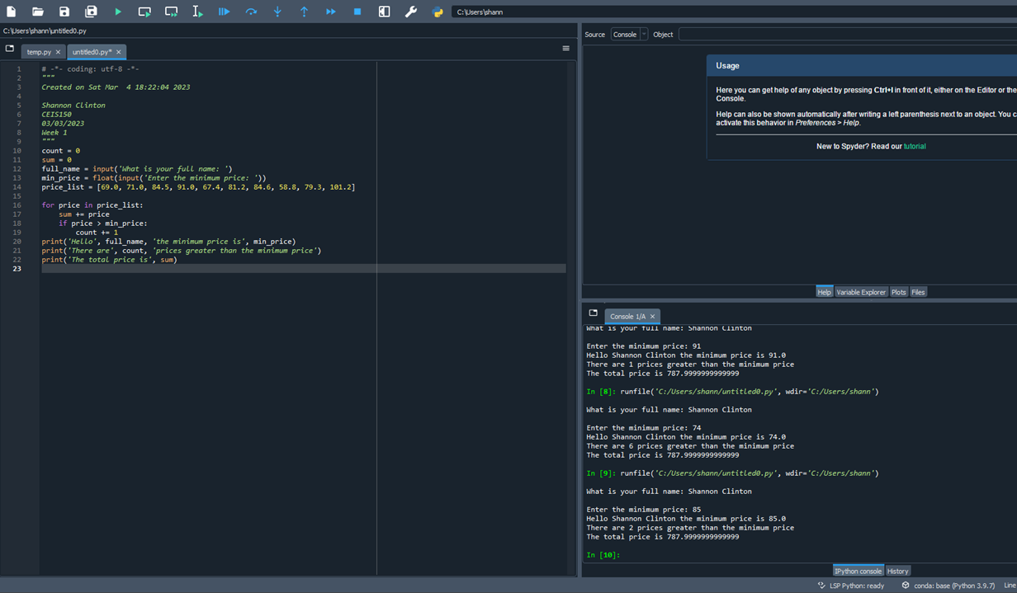
Module 1 – The first week we tested the IDE we had installed to make sure it was working

Slide 3
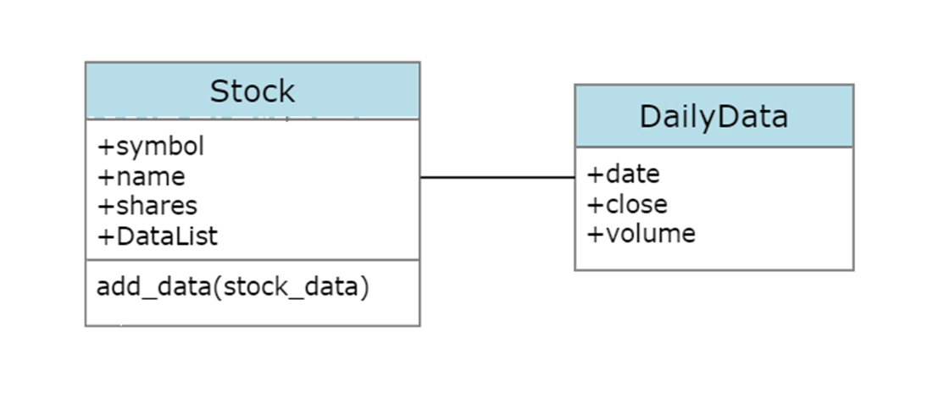
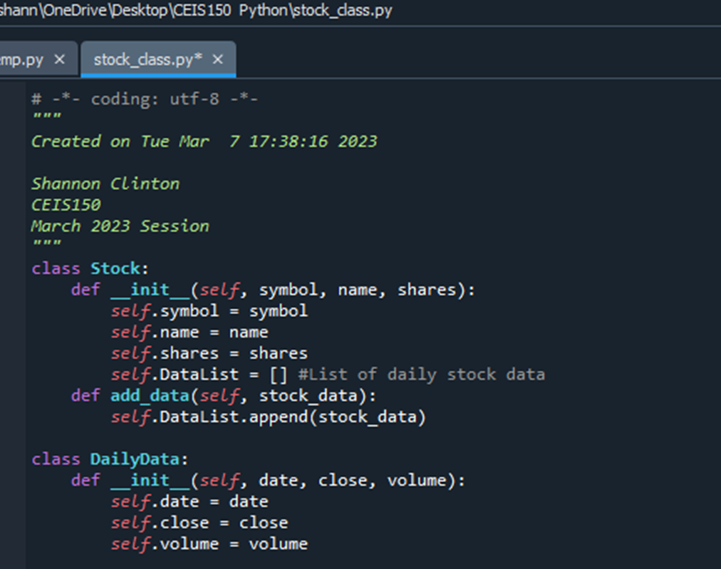
Module 2 – This week we created our UML for the classes we would be creating and we went ahead and created the classes as well

Slide 4
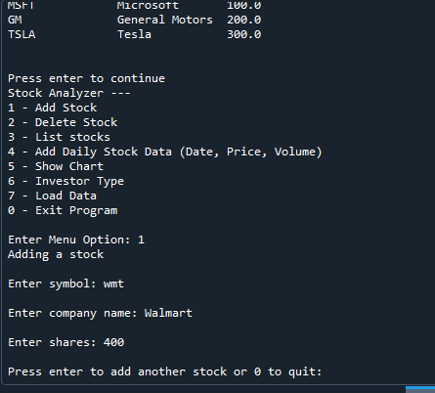
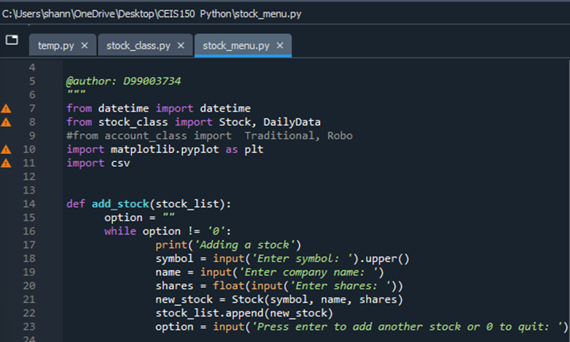
Module 3 – In week 3 we created a menu-driven user interface to Add/List/Delete stocks and to track the price and volume history of stocks
Adding a Stock

Slide 5
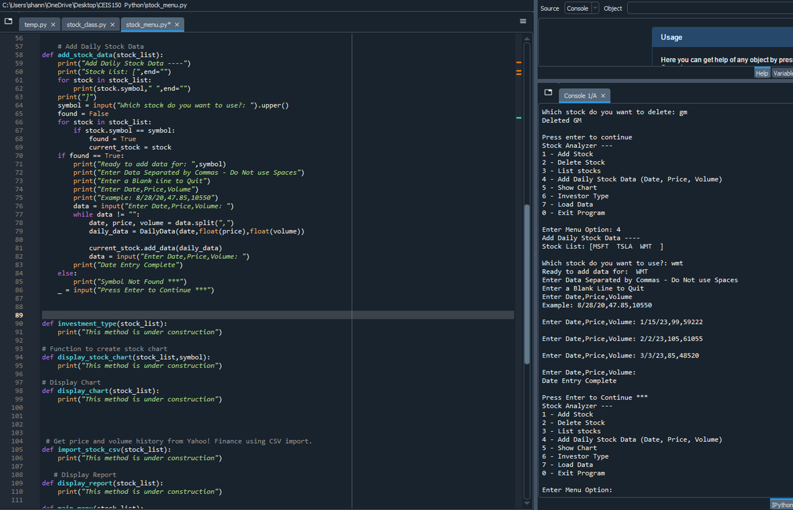
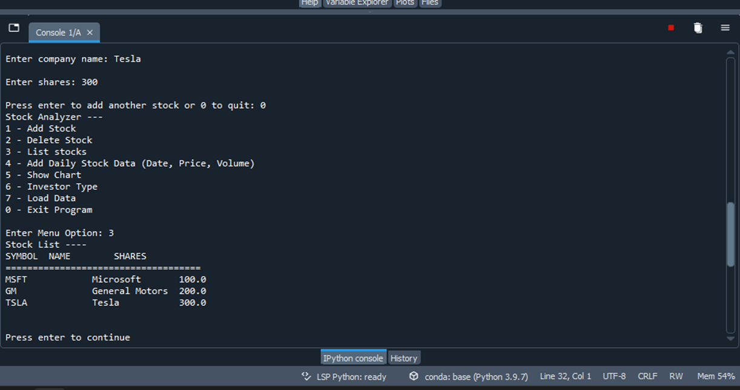
Show Daily Data
List Stocks

Slide 6
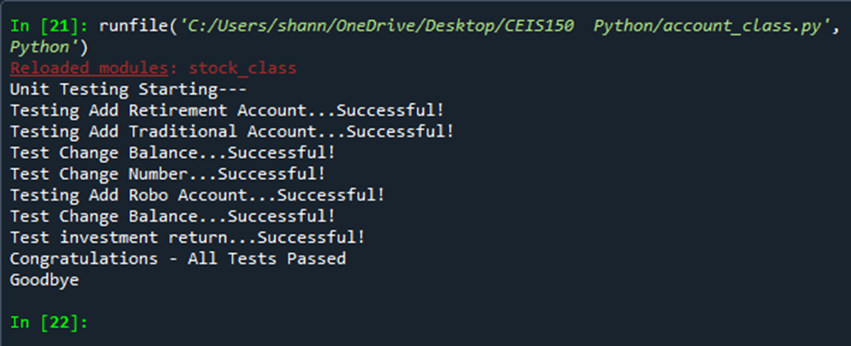
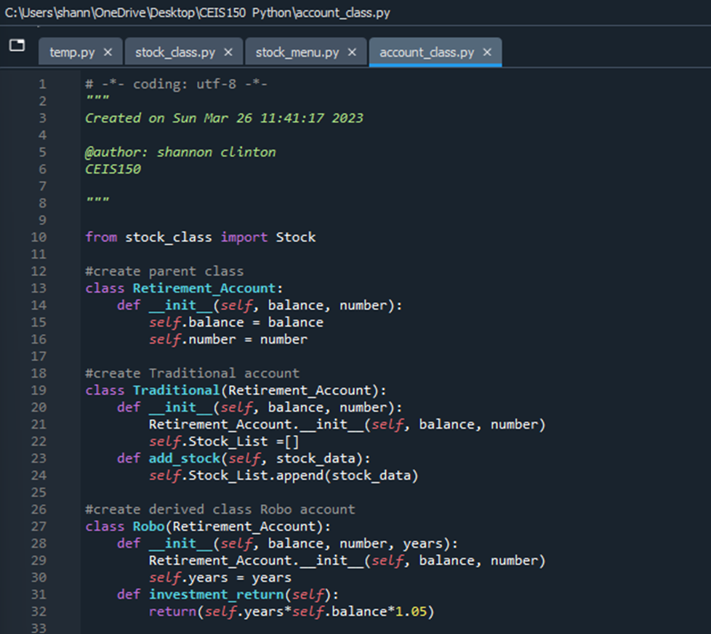
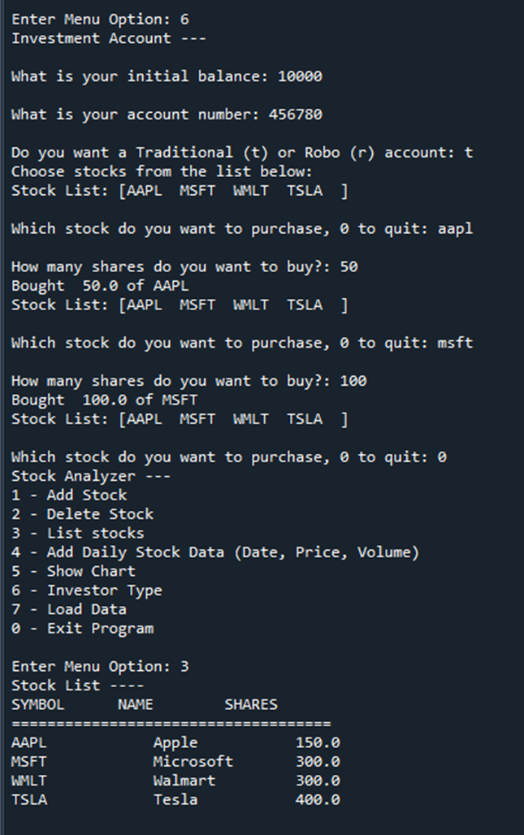
Module 4 - In week 4 we implemented inheritance in the stock program, created 3 classes, and ran a unit test

Slide 7
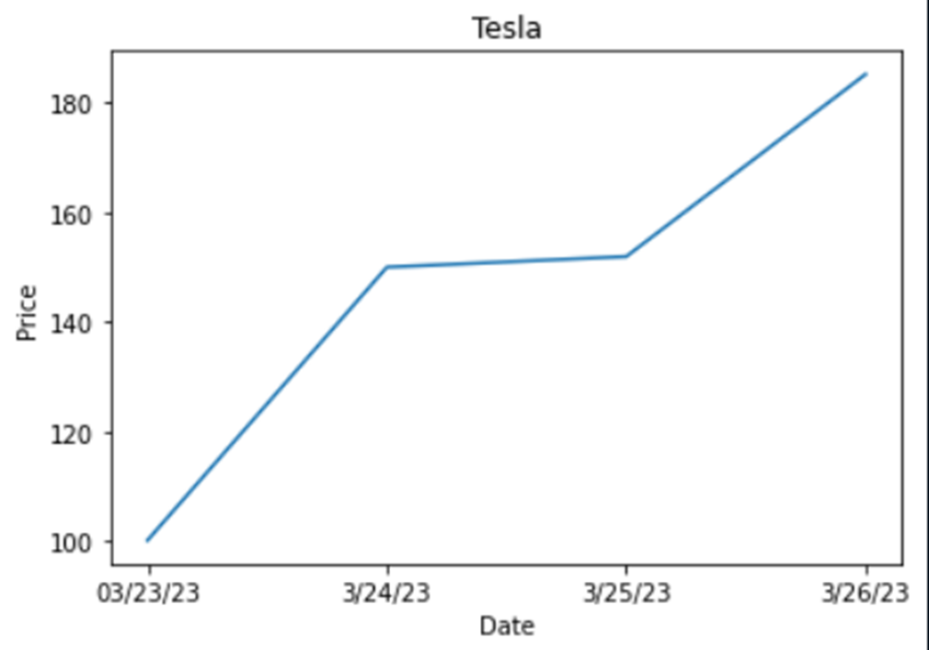
Module 5 – In week 5 we used matplotlib to create a stock chart

Slide 8
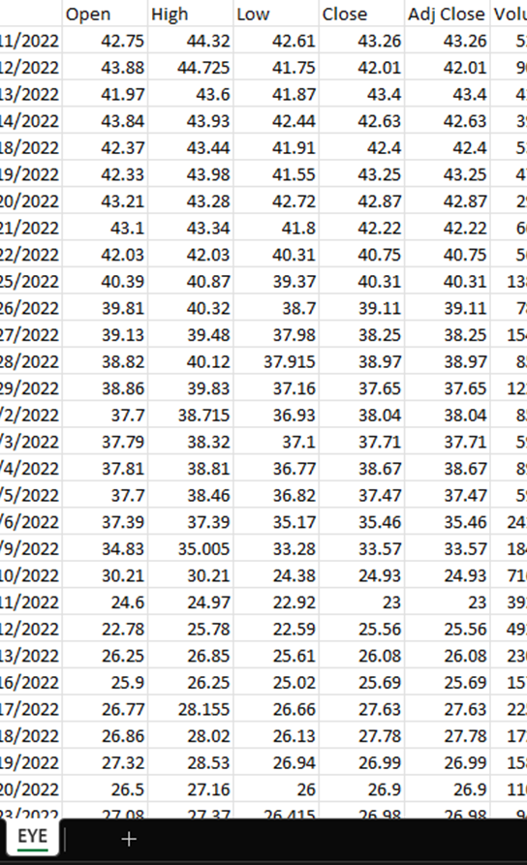
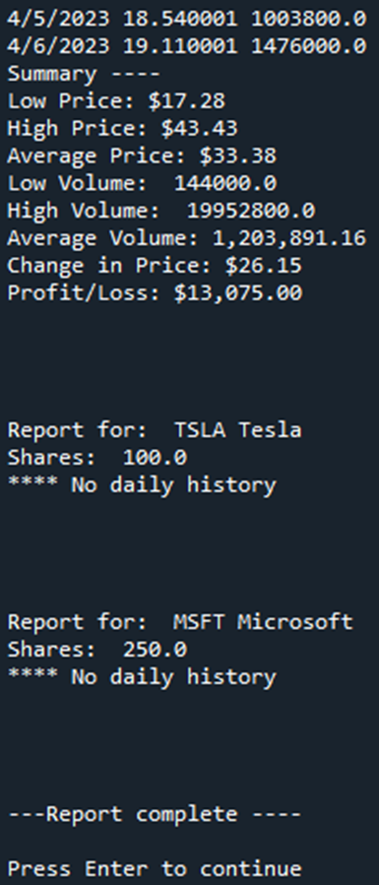
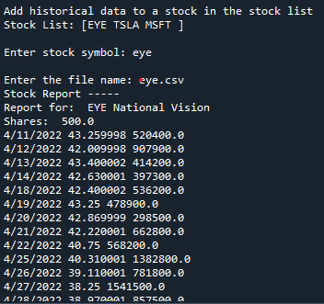
Module 6 - In week 6 we used the CSV Library to import data from Yahoo Finance and we read the data from the file

Slide 9
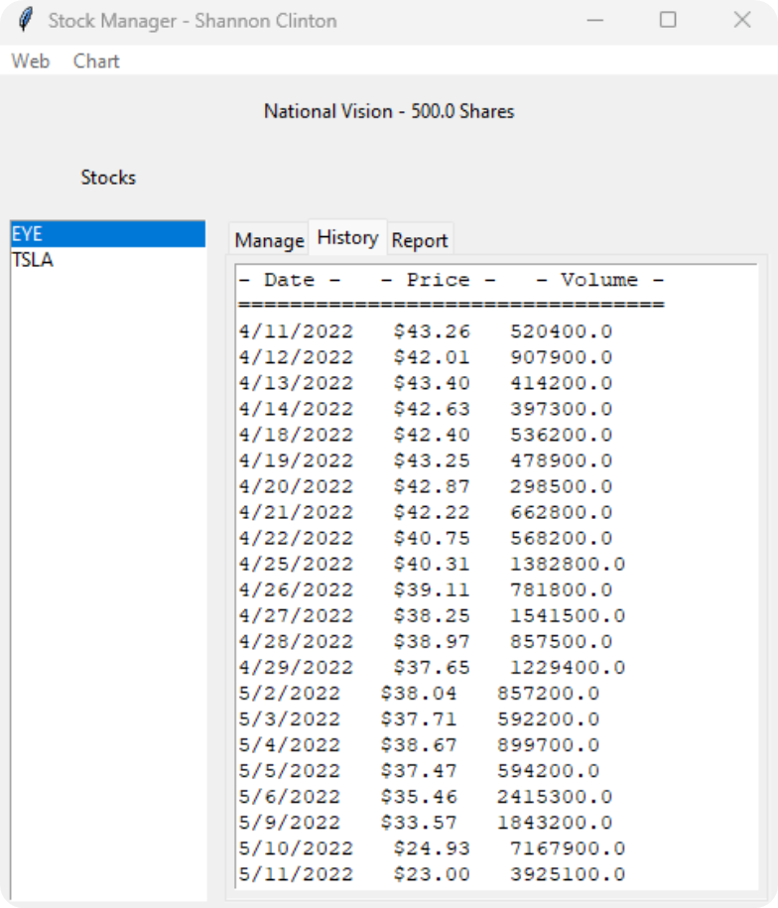
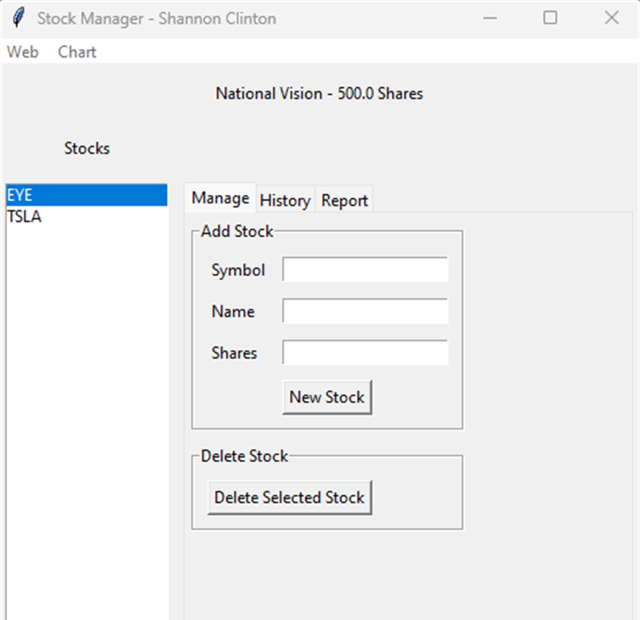
Module 7 – In week 7 we use Tkinter to create and implement a graphical user interface
History Tab
Creating GUI

Slide 10
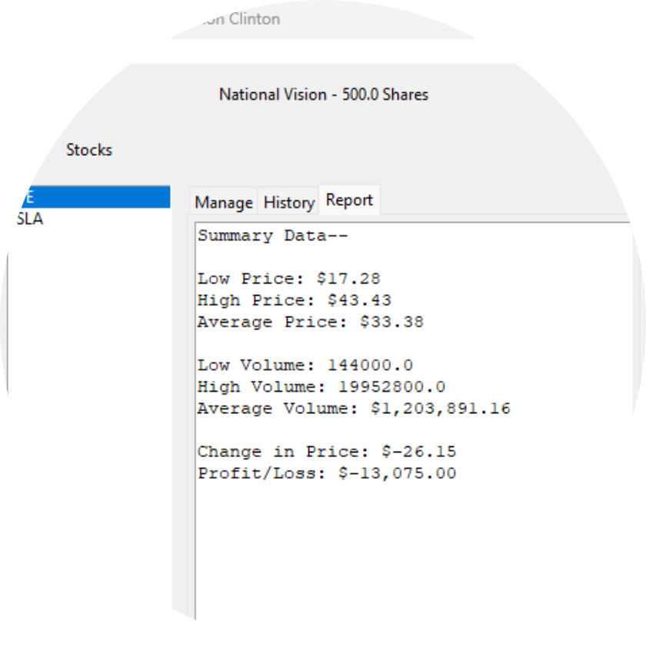
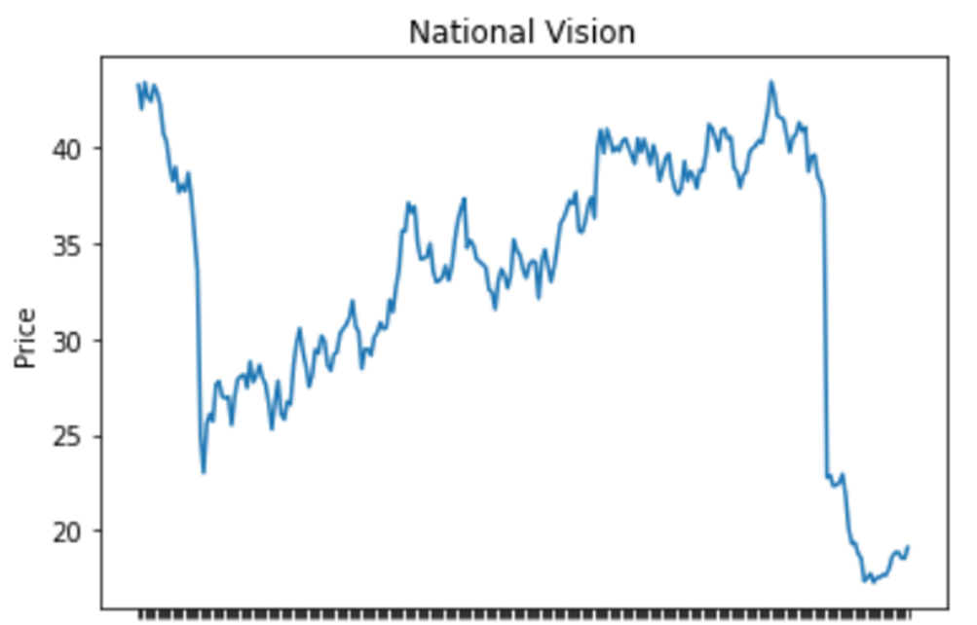
Report Tab
Chart of downloaded data

Slide 11

Conclusion
I really enjoyed this course as I learned a great deal. I will get a lot of use out of OOP in my future career because my degree’s concentration is in Big Data so the fact that the objects hold data makes OOP useful in data analysis. I look forward to expanding my understanding in this area in future courses as well

